Slide 1
Namespaces and scopes

Slide 2
Namespaces
Namespaces are just containers for mapping names to objects. Everything in Python - literals, lists, dictionaries, functions, classes, etc. - is an object. Such a “name-to-object” mapping allows us to access an object by a name that we’ve assigned to it.
For example, if we make a simple string assignment via a = "Hello string", we created a reference to the "Hello string" object, and henceforth we can access via its variable name a.

Slide 3
We can picture a namespace as a Python dictionary structure, where the dictionary keys represent the names and the dictionary values the object itself (and this is also how namespaces are currently implemented in Python), e.g.,
a_namespace = {'name_a':object_1, 'name_b':object_2, ...}
We have multiple independent namespaces in Python, and names can be reused for different namespaces (only the objects are unique), for example:
a_namespace = {'name_a':object_1, 'name_b':object_2, ...}
b_namespace = {'name_a':object_3, 'name_b':object_4, ...}

Slide 4
Every time we call a for-loop or define a function, it will create its own namespace. Namespaces also have different levels of hierarchy (Also called “scope”)

Slide 5
Scope
Namespaces can exist independently from each other and that they are structured in a certain hierarchy, which brings us to the concept of “scope”.
The “scope” in Python defines the “hierarchy level” in which we search namespaces for certain “name-to-object” mappings.
Example
i = 1
def demo():
i = 5
print(i, 'inside function')
print(i, 'global')
demo()

Slide 6
Output:
Global
inside function
Here, we just defined the variable name i twice, once in the demo function.
demo_namespace = {'i':object_3, ...}
global_namespace = {'i':object_1, 'name_b':object_2, ...}

Slide 7
Note:
If we want to print out the dictionary mapping of the global and local variables, we can use the the functions global() and local()
Example
#print(globals()) # prints global namespace
#print(locals()) # prints local namespace
glob = 1
def demo():
loc = 5
print('loc in demo():', 'loc' in locals())
demo()
print('loc in global:', 'loc' in globals())
print('glob in global:', ‘demo' in globals())

Slide 8
loc in demo() : True
loc in global : False
glob in global : True

Slide 9
Scope resolution for variable names via the LEGB rule
Multiple namespaces can exist independently from each other and they can contain the same variable names on different hierarchy levels. The “scope” defines on which hierarchy level Python searches for a particular “variable name” for its associated object.
The order in which Python search the different levels of namespaces before it finds the name-to-object’ mapping is – LEGB rule

Slide 10
Local -> Enclosed -> Global -> Built-in
where the arrows should denote the direction of the namespace-hierarchy search order.
Local can be inside a function or class method, for example.
Enclosed can be its enclosing function, e.g., if a function is wrapped inside another function.
Global refers to the uppermost level of the executing script itself, and
Built-in are special names that Python reserves for itself.

Slide 11
So, if a particular name:object mapping cannot be found in the local namespaces, the namespaces of the enclosed scope are being searched next. If the search in the enclosed scope is unsuccessful, too, Python moves on to the global namespace, and eventually, it will search the built-in namespace (side note: if a name cannot found in any of the namespaces, a NameError will is raised).

Slide 12
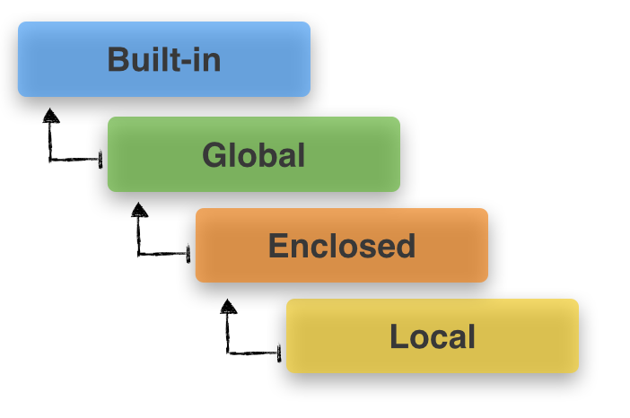

Slide 13
Local Scope :
Local scope refers to variables defined in current function. Always, a function will first look up for a variable name in its local scope. Only if it does not find it there, the outer scopes are checked.
Example:
# Local Scope
pi = ‘This is a global variable'
def test():
pi = ‘This is a local variable'
print(pi)
test()

Slide 14
Output
This is a local variable
On running the above program, the execution of the test function prints the value of its local(highest priority in LEGB rule) variable ‘pi’ because it is defined and available in the local scope.

Slide 15
Local and Global Scopes :
If a variable is not defined in local scope, then, it is checked for in the higher scope, in this case, the global scope.
Example
# Global Scope
pi = ‘This is a global variable'
def test():
pi = ‘This is a local variable'
print(pi)
test()
print(pi)

Slide 16
Output
This is a local variable
This is a global variable
Therefore, as expected the program prints out the value in the local scope on execution of test(). It is because it is defined inside the function and that is the first place where the variable is looked up. The ’pi’ value in global scope is printed on execution of print (pi).

Slide 17
Local, Enclosed and Global Scopes :
For the enclosed scope, we need to define an outer function enclosing the inner function, comment out the local pi variable of inner function and refer to pi using the nonlocal keyword.
Example
# Enclosed Scope
pi = ‘This is a global pi variable'
def outer_test():
pi = ‘This is outer pi variable'
def inner_test():
# pi = ‘This is inner pi variable'
nonlocal pi
print(pi)
inner_test()
outer_test()
print (pi)

Slide 18
Output
This is outer pi variable
This is a global pi variable

Slide 19
When outer_test() is executed, inner_test() and consequently the print functions are executed, which print the value the enclosed pi variable. Since pi is referred with the nonlocal keyword, it means that pi needs to be accessed from the outer_test function(i.e the outer scope). To summarize, the pi variable is not found in local scope, so the higher scopes are looked up. It is found in both enclosed and global scopes. But as per the LEGB hierarchy, the enclosed scope variable is considered even though we have one defined in the global scope.

Slide 20
Local, Enclosed, Global and Built-in Scopes :
The final check can be done by importing pi from math module and commenting the global, enclosed and local pi variables as shown below:
Example
# Built-in Scope
from math import pi
# pi = 'global pi variable'
def outer():
# pi = 'outer pi variable'
def inner():
# pi = 'inner pi variable'
print(pi)
inner()
outer()

Slide 21
Output
3.141592653589793
Since, pi is not defined in either local, enclosed or global scope, the built-in scope is looked up i.e the pi value imported from math module. Since the program is able to find the value of pi in the outermost scope, the above output is obtained.

